Slide 1
Hansen and Libecap
Externalities and Farm Efficiency and Collective Action to Internalize Them JPE 2004

Slide 2
Important Example of Wind Erosion
Dust Bowl in the Great Plains in 1930-1940
Wind carries topsoil away (480 tons per acre)
Damage also to human health and productivity losses $400 million annually.
Any farmer that protects by putting up large trees, allowing land to grow fallow etc. generates some benefits for his own farm but many of these benefits leak out to others, and the failure to do so also affected other farms to which sand was blown. Sand drifts bury crops.
Great plains have been largely deforested and farmer has incentive to use land as intensively as possible, hence not to let land be fallow.

Slide 3
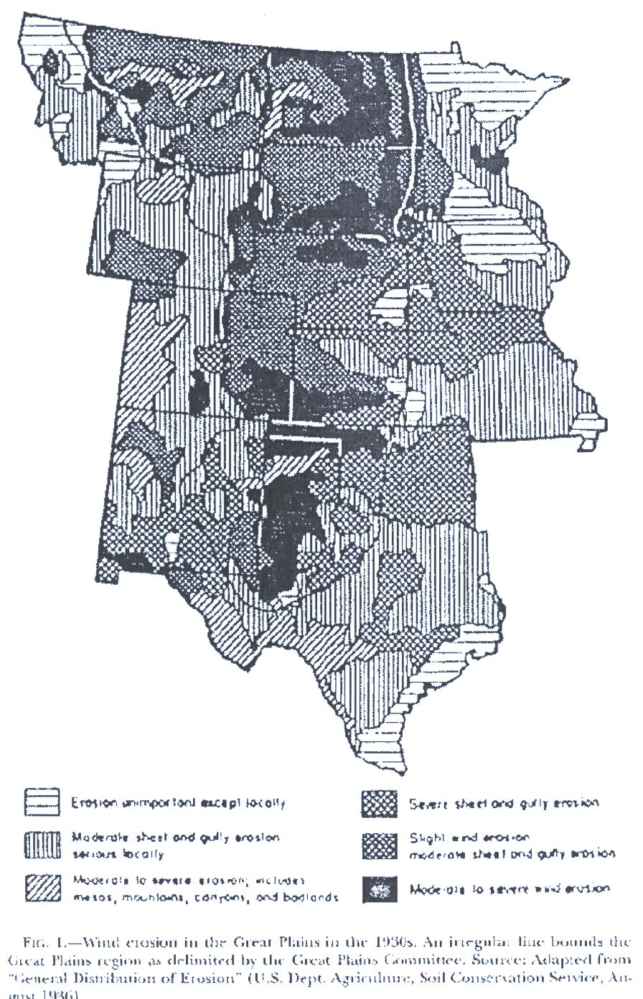
Map Showing Severity of Wind Erosion
North Dakota
Minnesota
Montana
Colorado
Kansas
Nebraska
New
Mexico
Oklahoma
Texas

Slide 4
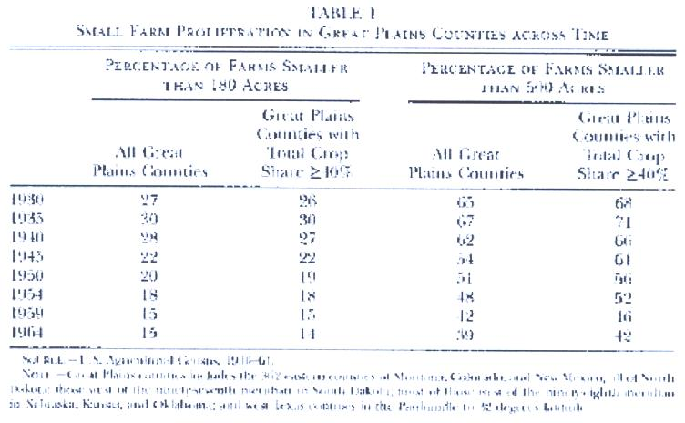

Slide 5
Comments on Table 1
In 1930 there was relatively high % of small farms, smaller than the size believed needed to reap economies of scale in dealing with wind erosion
Sharp decline over time in share of small farms
This decline coincided with decline in share of counties with crop share >= 40%
Collective Action or coordination needed to deal with the problem, especially so in areas with small farms since share of fallow land would be smaller (as shown in Table 2 for North Dakota in 1936) and cropped land is the most vulnerable to erosion

Slide 6
Estimates the relation between fallow share and farm size
FS_{i} = a +b₁S_{i} +b₂ S_{i}² +b₃d_{i} +e_{i}
Where S = Average farm size and d = estimated standard deviation of farm size in each county
Data Country level data for dust bowl states 1930-64

Slide 7
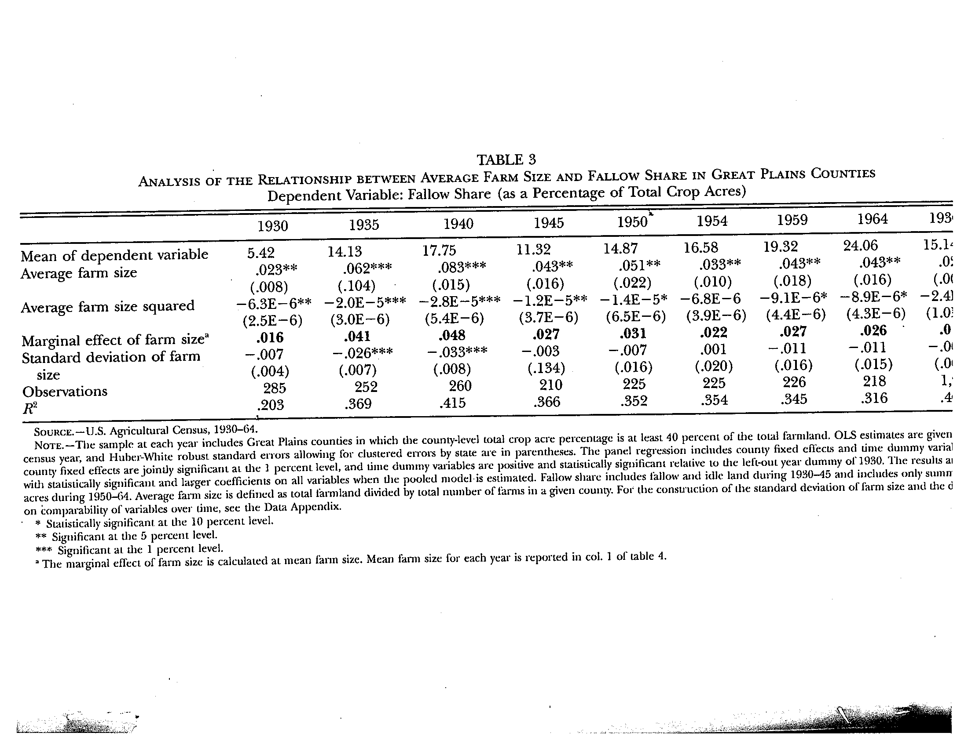

Slide 8
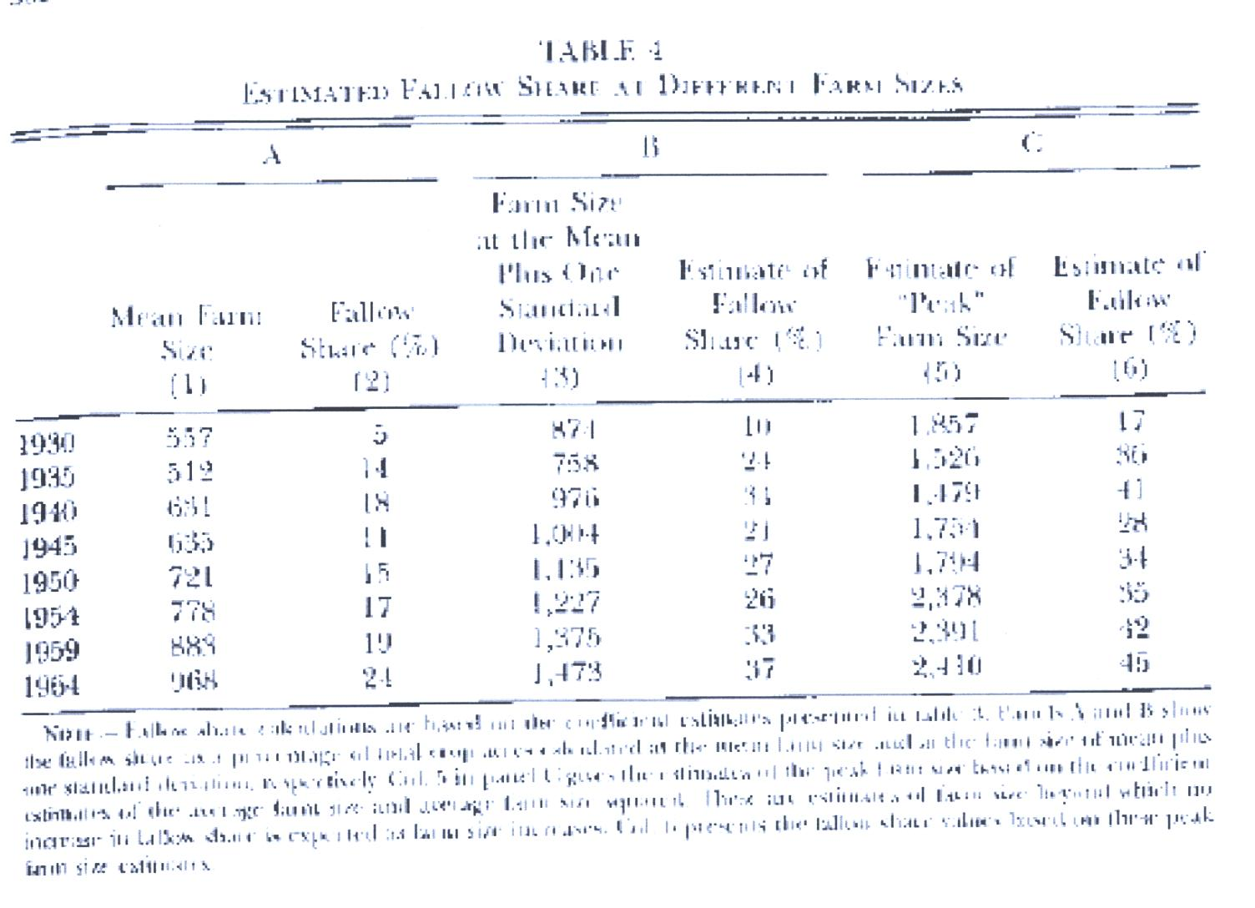

Slide 9
These results show how fallow share increased over time with mean farm size from 5% in 1930 to 24% in 1964 as mean farm size almost doubled. Higher % fallow but smaller increases over time for larger farm sizes.
Peak farm size rose somewhat from 1800 acres in 1930 to 2400 acres in 1964.

Slide 10
Estimate Function for Wind Erosion
WE_{i} = f ( rsd_{i} , t_{i}, w_{i}, c_{i} )
Where rsd_{i} is standard deviation of rainfall from normal levels 1930-5, t_{i} is % of sand in soil, w_{i} is average annual wind velocity , c_{i} is the % of county farmland cultivated
Uses both OLS and ordered probit since dependent variable is coded 0-3 by severity.
Comment: One could quibble with the accuracy of the data since it often pertained only to part of the country

Slide 11
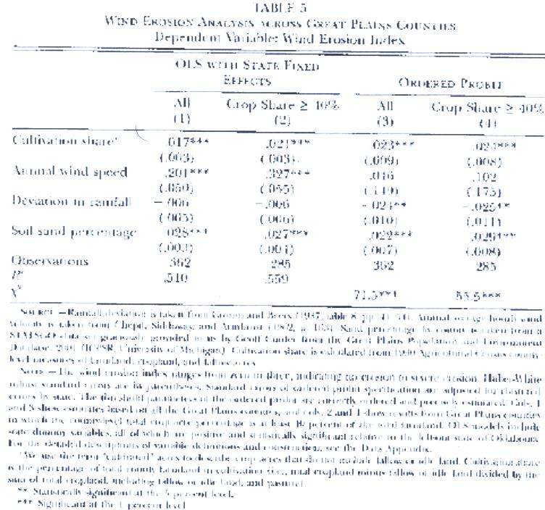

Slide 12
Results
Show that probability of wind erosion =3 rises from 16% to 58% if cultivation share rises from 50% to 100%
Since in 1930 most farms were below the size at which measures to combat wind erosion would be privately efficient, this posed huge collective action challenge.
Unfortunately the reaction was very delayed. Immediate hope was that the problem was only temporary.

Slide 13
Soil Conservation Service in 1934
Starts to have demonstration areas to show the benefits of farmer cooperation on this. But, as a result of farmers’ unwillingness cooperate, these not very successful.
Share of erosion control through fallow or strip cropping was 25% for cooperators and 14% for non-cooperators
Subsidies provided to cooperators, but reduced if compliance not found
The cooperators were generall larger farms than the small ones

Slide 14
Problem resolved only too late in late 1930s under the Roosevelt administration with coercive government intervention providing strong incentives for farmers to participate in Soil Conservation Districts (SCDs) and the activities thereof.
SCDs began only in 1937
These required action by the state and were local government units.
Not surprisingly states with the most severe wind erosion problems (Texas, Oklahoma and Kansas) were the first states to pass legislation in 1935

Slide 15
Programs varied by state
All with some coercion
SCDs were all very large 250,000 -600,000 acres
Within districts farmers entered into contracts with SCD on reducing soil erosion over 5 years
SCD provided materials, technical assitance, fencing, Land use regulations could be binding on all if adopted by a majority of farmers in the district. District supervisor could do and charge to the farmer with 5% penalty if the farmer did not do what was required. Could also get loans from the Farm Security Administration
Evidence from Farm service in Montana that it was larger farmers who bore the costs of failures were the major supporters of SCDs. (Data for only 3 counties!!!)

Slide 16
Political Economy Issues: Internalizing Externalities
Hansen and Libecap 2004
Show that the Dust Bowl of the 1930s in Great Plains caused by failure to prevent the harmful effects due to wind erosion (Figure 1)
Importance of issue for LDC regions believed to be becoming increasingly arid. (SSA, Central Asia and MENA)
Large farms more successful than small farms but success required collective action which because of heterogeneity among farmers was insufficient at the time. Higher coordination costs for small farms.
Small farms would have less fallow and cause more problems for large farms than would large farms.

Slide 17
With such strong incentives provided by the state, why did SCDs not do better?
Hansen and Libecap: greater success where problem was most serious and with larger farms
But what about?:
  1.Variations in suitability of techniques to the local circumstances
  2. Heterogeneity of farmers in the groups?
  3.Variation in access to outside services and finance
  4. Size of SCD (Tradeoffs in Collective action)
  5. Governance: What should be the critical minimum support for such schemes to be compulsory for all members? (Lots of agricultural schemes in US such as those for all growers of certain crops to pay fees and abide by rules of Growers Associations)

